Slide 1
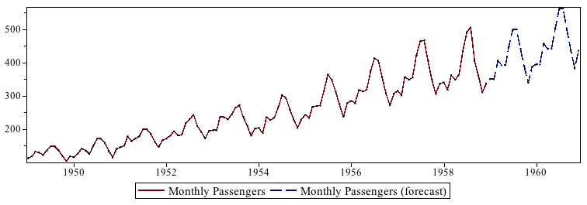
Business Analytics
Time Series Modeling

Slide 2
What is Time Series data?
Any data which is captured over a period of time with equal interval!!
Interval could be:
Yearly
Monthly
Weekly
Daily
Hourly

Slide 3
Time Series data..!! Call volumes of a BPO
Day | Denoted by | Call Volume
10/25/2014 | Yt | 99,552
10/24/2014 | Yt-1 | 113,014
10/23/2014 | Yt-2 | 118,502
10/22/2014 | Yt-3 | 119,437
10/21/2014 | . . . . | 123,410
10/20/2014 | . . . . | 129,368
10/19/2014 | . . . . | 135,961
10/18/2014 | . . . . | 131,698
. . . | . . . . | . . . .
. . . . | . . . . | . . . .
2/23/2014 | Yt-p | 113,214

Slide 4
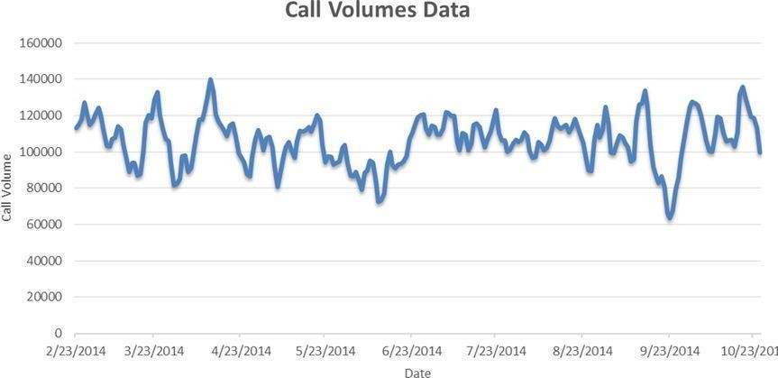
Time Series data trend!! - Plot the data

Slide 5
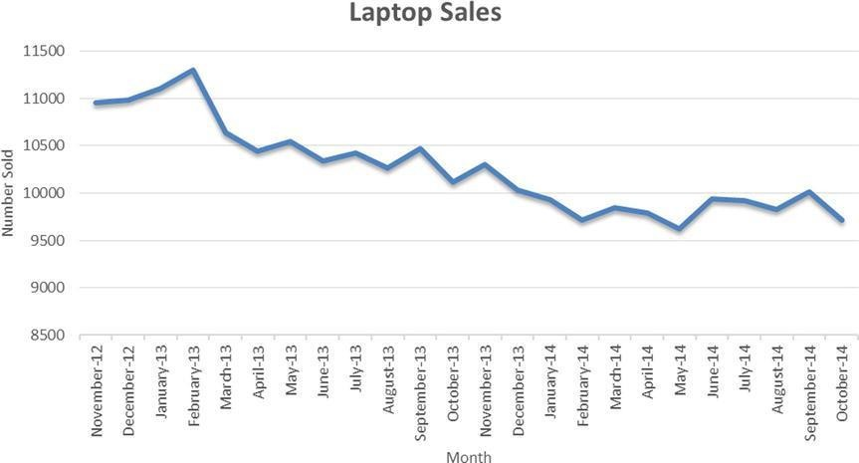
Time Series data plot!! – Some more examples..

Slide 6
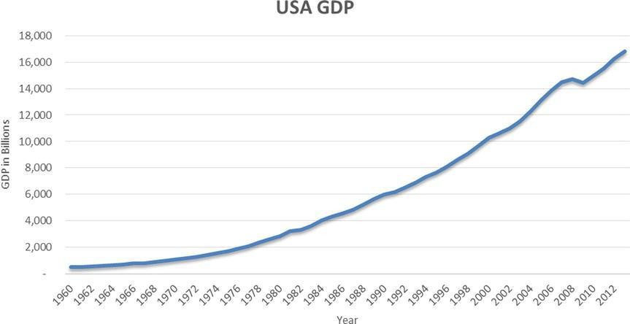
Time Series data plot!! – Some more examples..

Slide 7
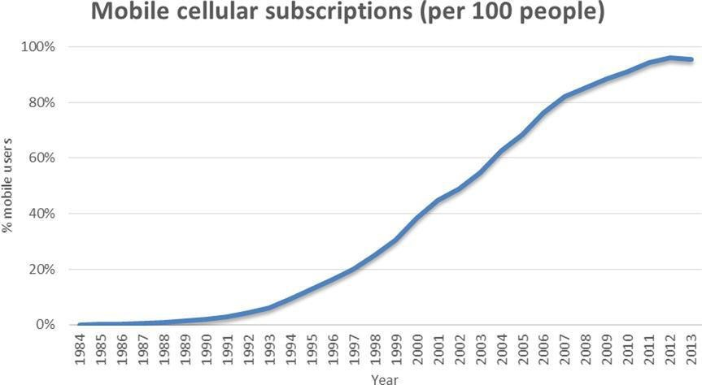
Time Series data plot!! – Some more examples..

Slide 8

Major phases of the technique..!!

Slide 9
Descriptive Analysis..!!
– Try to understand the nature of the time series
If it has any trend...if it has then how does it look like – upward, downward
If there is any seasonal pattern

Slide 10
Modeling..!!
– There are several techniques to model it
– Box–Jenkins Approach

Slide 11
Box–Jenkins Approach
– This is also popularly known as ARIMA
AR-I-MA
AR
– MA
– I

Slide 12
ARMA(p,q)
#An ARMA(2,1) series is written as follows:
Yt = a1*Yt-1 + a2*Yt-2 + εt + b1*εt-1
#ARMA(p,q)
#Yt = a1*Yt-1 + a2*Yt-2 + a3*Yt-3 + . . . ..+ ap*Yt-p
+ εt + b1*εt-1+ b2*εt-2. . . .. . . .+ bq*εt-q
#a1, a2, a3, . . . . ap are quantified impacts of Yt-1
,Yt-2, . . . . Yt-p on Yt
#b1, b2, . . . . bq are quantified impacts of εt-1 and εt-2 . . . εt-q on Yt.

Slide 13
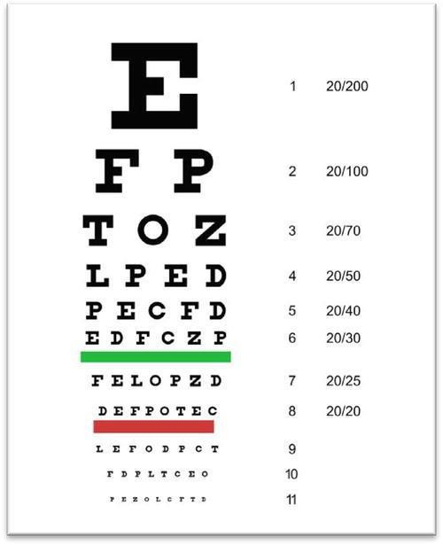

Have you ever experienced this??

Slide 14
Steps for the Eye test..!!
1. Assume that patient is literate.
2. Based on some tests, identify nearsightedness or farsightedness and get a rough estimate of eyesight.
3. Estimate the exact eyesight by trying various lenses.
4. Use the test results to give the prescription.

Slide 15
Similar steps you follow for ARIMA
Test whether the data is stationary
Determine the order of AR and MA
Use the the accuracy test to conclude the best model
Forecast using the best model

Slide 16
What is stationary??
A time series is stationary if it doesn’t have any trend.
You should also ensure that there is no systematic change in variance.

Slide 17
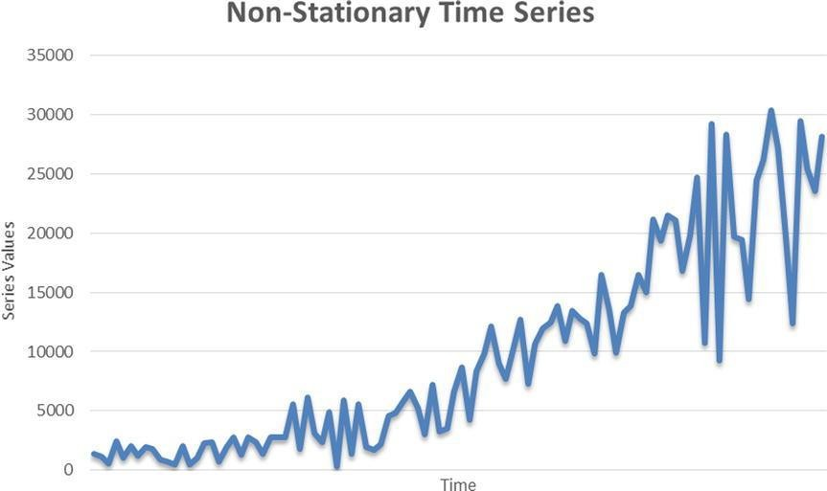
Non stationary series looks like..

Slide 18
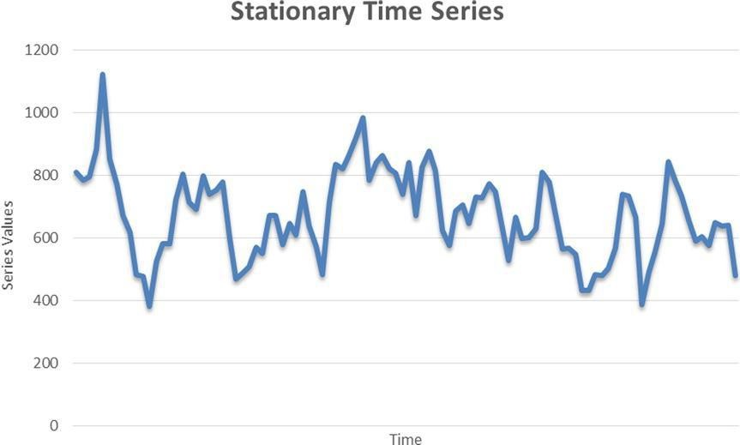
Stationary series looks like..

Slide 19
How to test whether a data is Stationary?
Augmented Dickey Fuller (ADF)
H0: The series is not stationary.
H1: The series is stationary.
Low p value indicates that the data is stationary

Slide 20
If the data is not Stationary?
Differnce the data to make it stationary!!
Order of difference is (d)
Opposite of differnce is integration
ARIMA (p,d,q)

Slide 21
Comparison between models..!!
MAPE
RMSE
MAE
MAD
MASE
Lowest value indicates better model..!!

